Slide 1
Road Accident Data Analysis

Slide 2
Objective
To analyze road accident data to identify trends, patterns, and contributing factors, enabling the development of data-driven insights to improve road safety, optimize traffic management, and inform policymaking through statistical analysis, data visualization, and predictive modeling.

Slide 3
Tools Used: MS Excel Techniques Used: Data Cleansing Data Visualization Pivot Tables Power Query Editor Graphs and Charts KPI’s

Slide 4
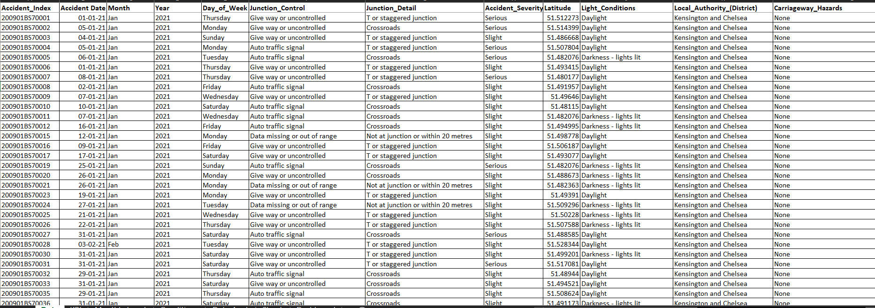
Dataset Description:
The dataset contains road accident data from the UK. It comprises 307,973 rows and 18 columns. The details of the dataset are as follows:

Slide 5
Accident_Index = unique accident case number Accident date = date of accident occurred Junction_Control = how the traffic is controlled at that junction (Give way or uncontrolled , Auto traffic signal ) Junction_Detail = type of junction (Crossroads , T or staggered junction, …) Accident _Severity = intensity of the accident (slight, serious, …) Latitude = geographical conditions of the area Light_Conditions = conditions of the light in the area (Daylight, Darkness - lights lit , …) Local_Authority (District) = Authority of Administration where the accident took place (Kensington and Chelsea, Westminster , …) Longitude = geographical conditions of the area Number_of_Casualities = no of accidents took place on that place in that area Number_of_vehicles = no of vehicles Police_Force = type of police (Metropolitan Police, Warwickshire, …) Road_Surface_Conditions = condition of the roads (Dry, Wet or damp, …) Road_Type = type of roads (One way street, Single carriageway, …) Speed_limit = maximum limit of the speed for the vehicles Urban_or_Rural_Area = type of area (Urban, Rural, …) Weather_Conditions = climate in the area (Fine no high winds, Raining no high winds, …) Vehicle_Type = type of vehicles (car, taxi, bike, …)

Slide 6
Data Cleaning:
Data had some blanks/ missing values. So removed those blanks and unwanted values.
Removed unwanted columns like Longitude, Latitude, Carriageaway_Hazards, Speed_Limit, Junction_Type, Junction_Control and Time.
Reomved Extra and Unwanted Spaces using “TRIM” function.

Slide 7
Data Preprocessing
Extracted “Month”, “Year”, “Day_of_Week” using “Accident_date” column.

Slide 8
Recommended Analysis
What are the total number of causalities till date?
Which type of casualties occur more frequently in accidents?
What is the distribution of types of casualties?
How do casualty trends compare between the previous year and the current year?
Give the area-wise distribution of casualties.
Give the light wise distribution of casualties.
Give the road-wise distribution of casualties.

Slide 9
Data Analysis
What are the total number of causalities till date?
There are 417883 total casualties till date.
Which type of accidents occur more frequently?
Car accidents (3,33,485) occur more frequently followed by Goods vehicles (33,472) and Bus (12,798).
What is the distribution of type of casualties?
Slight casualties (84.1%) occur more frequently in accidents followed by Serious casualties (14.2%) and Fatal casualties (1.7%).

Slide 10
How do casualty trends compare between the previous year and the current year?
We can see a drop in accidents in the year 2022 as compared to 2021 in each months.
Give the area-wise distribution of casualties.
There are more accidents in Urban area (61%) as compared with Rural area (39%).
Give the light wise distribution of casualties.
- Most accidents have occurred in daylight rather than in darkness.

Slide 11
Give the road-wise distribution of casualties.
- Most of the accidents occur when there is Single carriageway (309.7K) followed by Dual carriageway (67.4K) and Roundabout (26.8K).

Slide 12
Conclusion:
We can observe that the road accidents are more where the road surfaces are “Dry”.
Although there is slight decrease in accidents this year as compared to previous year, there should be some major improvements in road conditions.
Car accidents require major attention, as they account for the highest number of accidents.
Casualties can be reduced if people take proper precautions while driving, walking, etc.

Slide 13
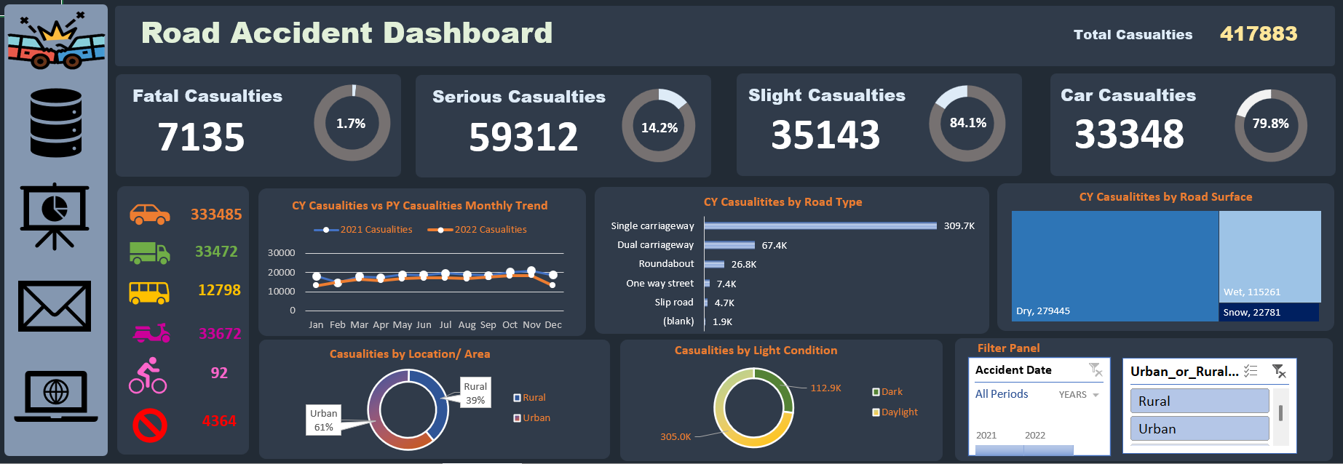
Dashboard:

Slide 14
Thank You.

